Slide 1
CSC 3210 Computer Organization and Programming
Lab Work 3
Dr. Zulkar Nine
mnine@gsu.edu
Georgia State University
Spring 2022

Slide 2
Lab Work 3 Instructions
Lab 3(a): Load and build an existing project (3 points)
Lab 3(b): Debug the Project (3 points)
Lab 3(c): Math Problems (2 points)
Due Date: Posted on iCollege

Slide 3
Disclaimer
The process shown in these slides might not work in every single computer due to Operating system version, Microsoft Visual Studio versions and everything.
If you find any unusual error, you can inform the instructor.
Instructor will help you resolve the issue.

Slide 4
Attendance!

Slide 5
Lab3(a) Load and Build an existing project
in Microsoft Visual Studio

Slide 6
Lab 3(a) Instructions
Follow the instructions to build the project.
Take screenshot/screenshots showing the code, and the output window. The output window must show that the project was built successfully.
Submit to the iCollege.

Slide 7
Load an existing project
In this lab, you load an existing project.
Follow the steps :
Step 1: Download the project
Step 2: Load the project into Microsoft Visual Studio
Step 3: Build the project

Slide 8
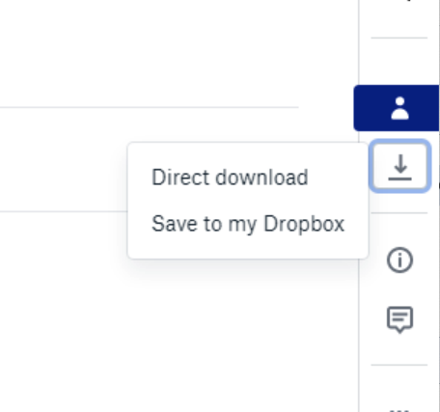
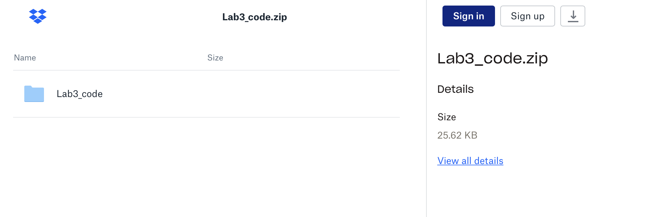



Step 1: Download the Project (1)
Now download a project from the link:
https://tinyurl.com/lab3codefall21
Click Direct Download
Most likely it is downloaded in your ‘Downloads’ folder.

Slide 9
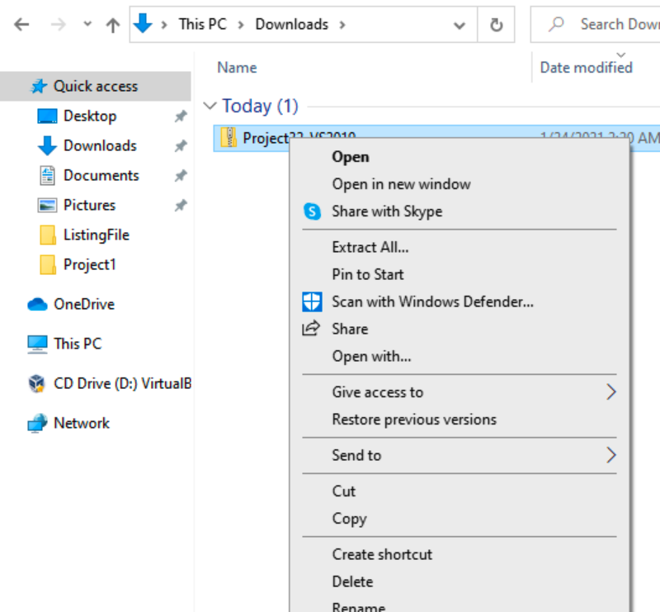

Step 1: Download the project (2)
Go to the folder where it is downloaded
Unzip the downloaded file
Right click on the zip file
Click Extract All…

Slide 10
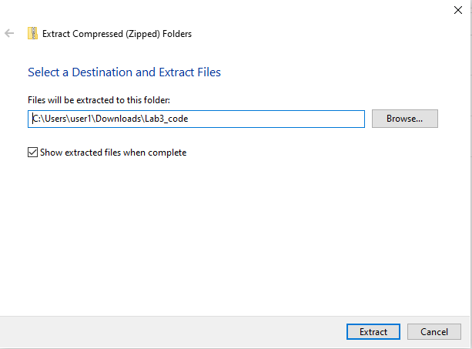

Step 1: Download the project (3)
Remove “Lab3_code” from the path.
(keep the forward slash at the end)

Slide 11
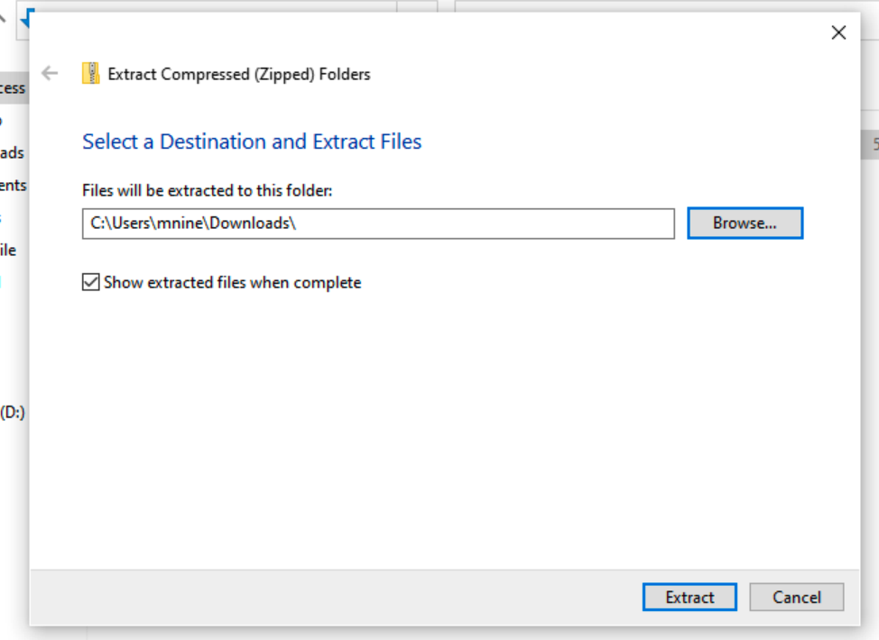



Step 1: Download the project (4)
The path should look like
Click Extract button
It will extract the files in
a folder named –
Lab3_code
in your current directory.

Slide 12
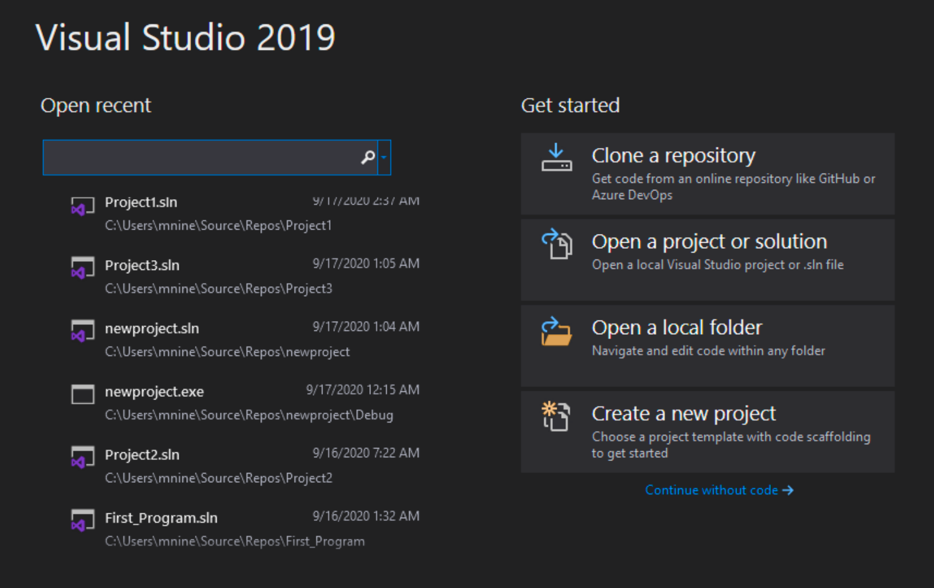


Step 2: Load the project into Visual Studio (1)
Open Microsoft Visual Studio
Click “Open a project or solution”

Slide 13
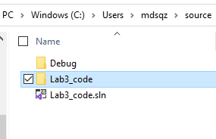


Step 2: Load the project into Visual Studio (2)
Browse to the directory where you saved the extracted project “Lab3_code”.
Go inside the folder “Lab3_code”.
Select ‘Lab3_code.sln’ file.
Click Open button at the bottom right corner.
You might see a security warning.
If you see one : click OK.
The project will be loaded in you Microsoft
Visual Studio.

Slide 14
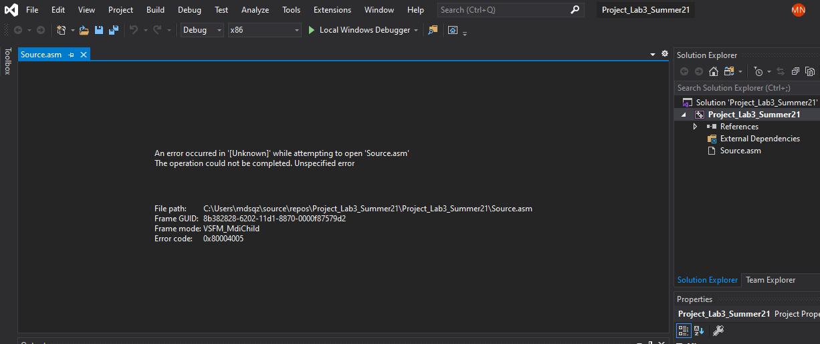


Step 2: Load the project into Visual Studio (2)
If you see the following error!
Close the Source.asm file by clicking ‘X’
Then follow the next slide

Slide 15
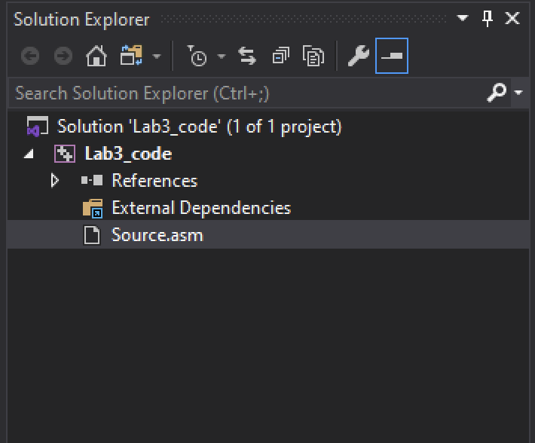


Step 2: Load the project into Visual Studio (3)
Once the project has been opened, you will see the project name in the Solution Explorer window.
You should also see an assembly language source file in the project named Source.asm.
Double-click the file name to open it in the editor.

Slide 16
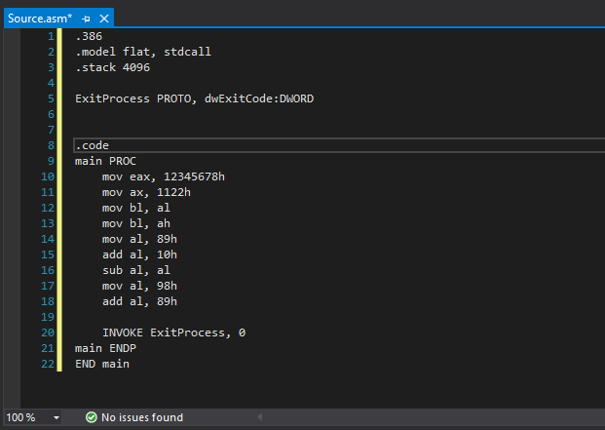
Step 2: Load the project into Visual Studio (4)
You should see the source code in the editor window

Slide 17
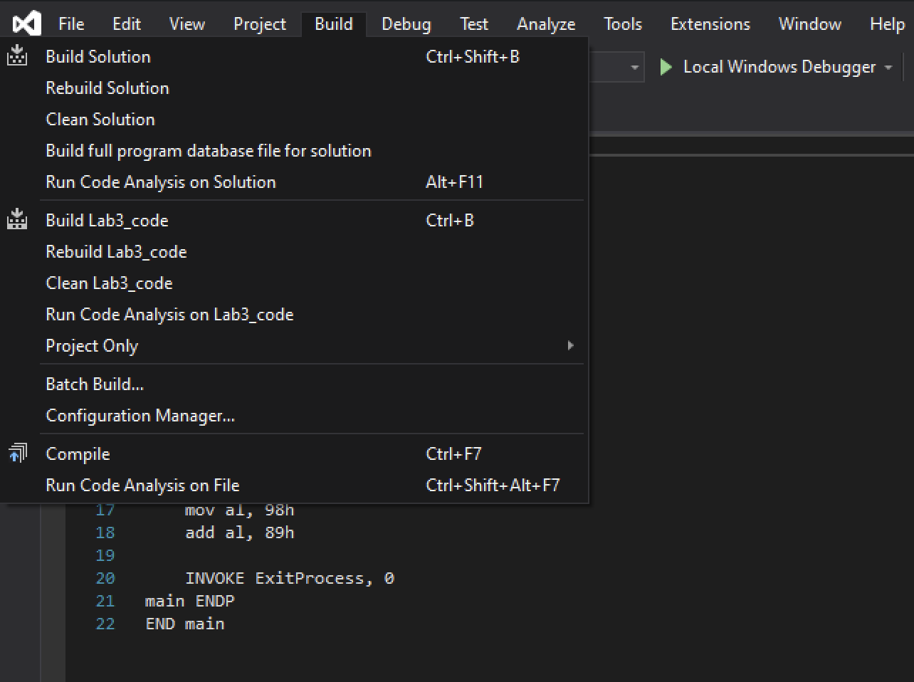

Step 3: Build the Project (1)
Select Build Project from the Build menu.
This will assemble and link your program and create an executable file.

Slide 18
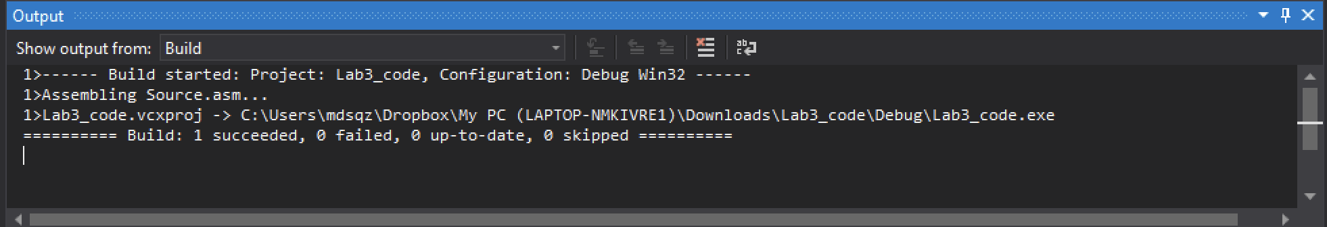
Step 3: Build the Project (2)
You should see messages like the following in your output window, indicating the build progress:
﻿You should see the message in the last line:
=====Build: 1 succeeded, 0 failed, 0 up-to-date, 0 skipped =====

Slide 19
Lab 3(b) Debug the project code
And record the register and flag contents

Slide 20
Lab 3(b) Submission Instructions
An answer sheet is provided with this lab for Lab 3(b).
You need to debug the code
Stop for each instruction and record the register content in the answer sheet. Then explain the register content.
Submit your answer sheet to the iCollege.

Slide 21
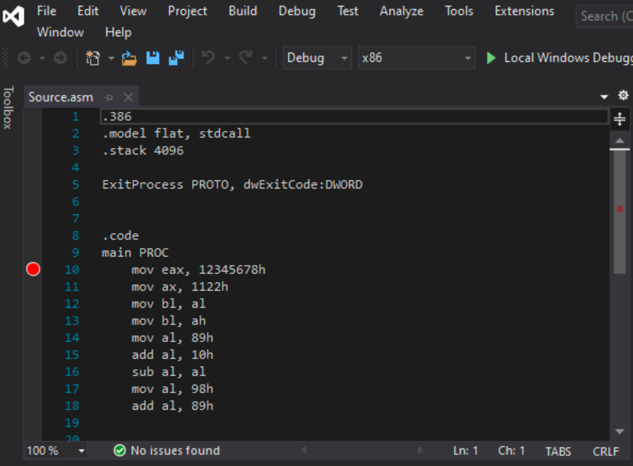

Debug the Project
Set a breakpoint first.
Set a breakpoint on a program statement by clicking the mouse in the vertical gray bar just to the left of the code window.
A large red dot will mark the breakpoint location.
In this case, set a breakpoint at Line 10.

Slide 22
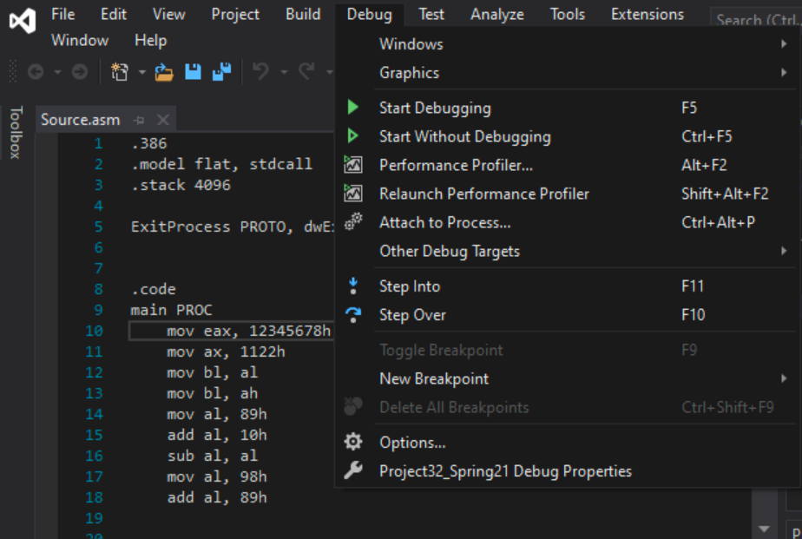
Debug your code
Run the Program by selecting Start Debugging from the Debug menu.

Slide 23
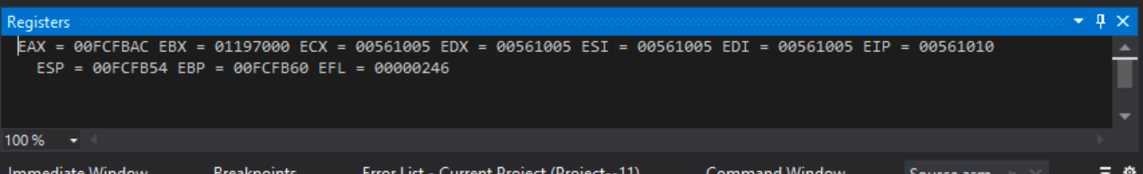
Debug the Project
You should be able to see the register window :

Slide 24
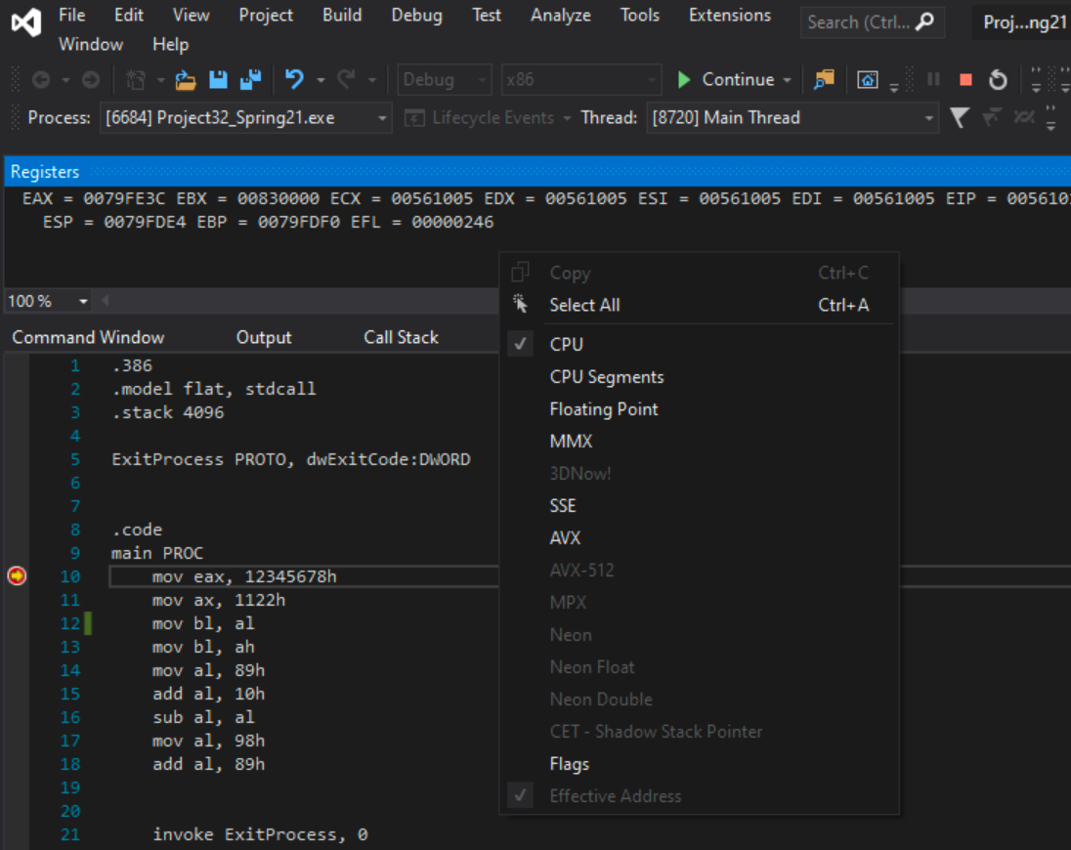
Debug the project
Turn on the EFLAGS in the register window.
Right click on the register window
Then check the flag

Slide 25
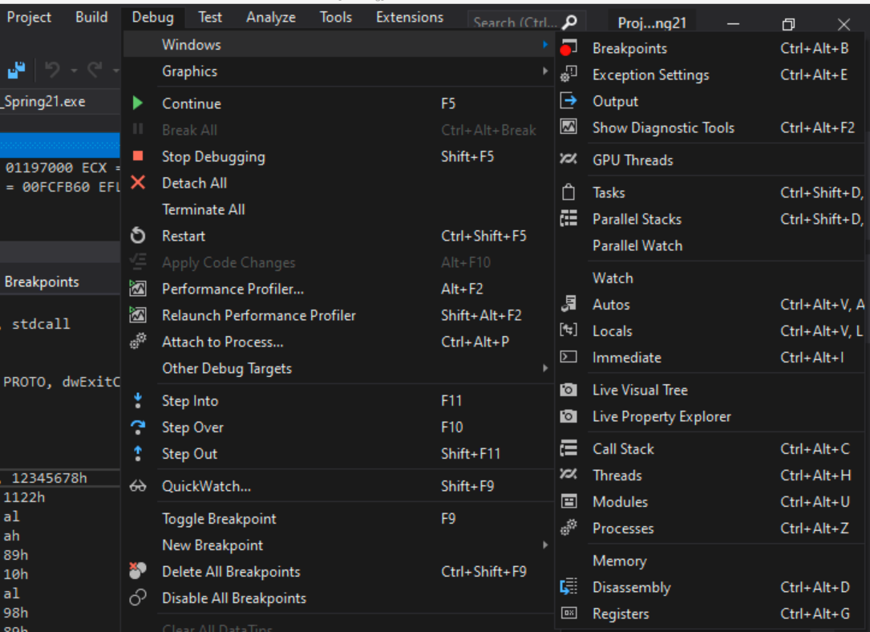

Debug the Project
You must be inside debug mode:
If you are not in debug mode : Go to Debug -> Start debugging
If you don’t see the register window: Go to : Debug ->Windows->registers.

Slide 26
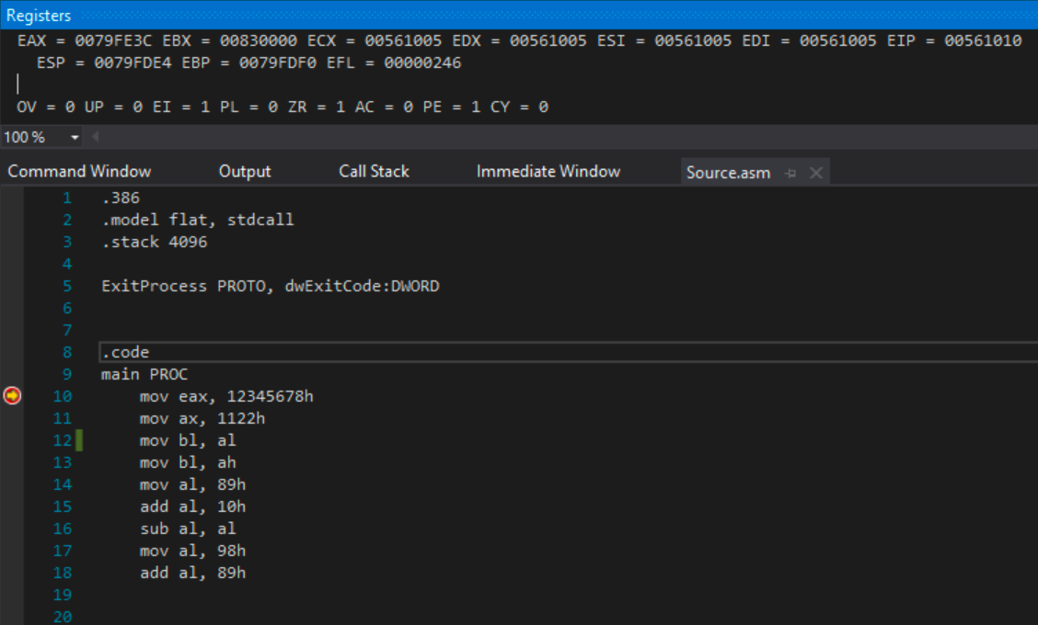

Debug your code
Now the red dot (breakpoint) has a yellow pointer inside of it now.
That means code execution halts at line 10 now.

Slide 27
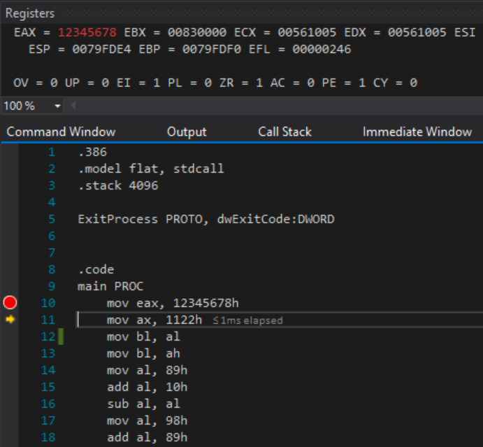

Debug the Project
To execute line 10, Select ‘Step over’ from debug menu
You can also use shortcut : Fn+F10
Now the yellow pointer moved to line 11. That means line 10 is executed.
Check the EAX register content.

Slide 28
mov Instruction
mov instruction has two inputs – first one is destination and second one is source.
mov destination, source
mov instruction copy the source content to the destination.
It is more like assignment operation in high level language.
In the Code, Line 10
Mov eax, 12345678h
Here 12345678 is a hexadecimal number. Radix ‘h’ after the number indicates that it is a hex.
This can be converted to 32-bit binary number. (Try convert it to binary)
Mov instruction stores that value to EAX register that is also 32-bit register.
After executing line 10, you can see the content change in EAX register.

Slide 29

mov Instruction
Eax contains 12345678
(all the register values are in hexadecimal)

Slide 30
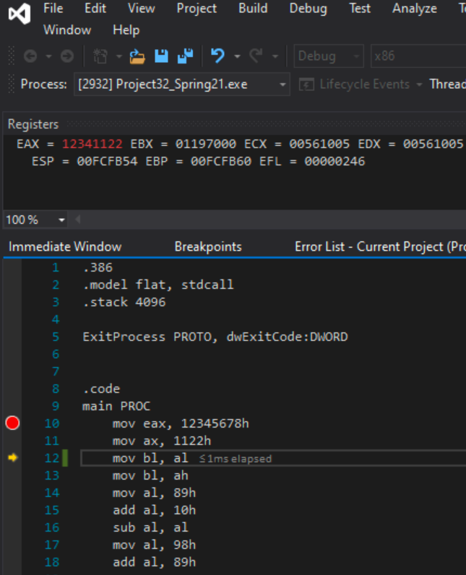


Debug : Line 11
To execute line 11, Select ‘Step over’ from debug menu
You can also use shortcut : Fn+F10
Mov ax, 1122h
Here 1122 is a hex and it is 16 bit.
AX is also a 16-bit register.
After executing the mov instruction,
Only AX part (lower) of EAX register updated.
The upper part is unchanged.

Slide 31
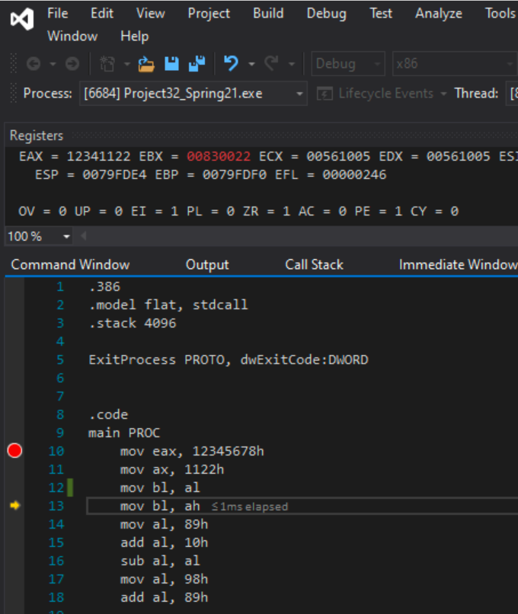


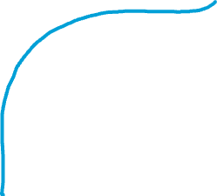
Debug: Line 12
To execute line 12, Select ‘Step over’ from debug menu
You can also use shortcut : Fn+F10
Mov bl, al
Here the content of AL register is moved to the BL register.
AL register is the lower 8-bit of the EAX register.
It contains 22 now.
22 is a hex
BL is the lower 8 bit of EBX register
BL is the destination here
After executing this line, BL contains 22 as well. However, rest of the EBX register remains unchanged with previous garbage values.

Slide 32
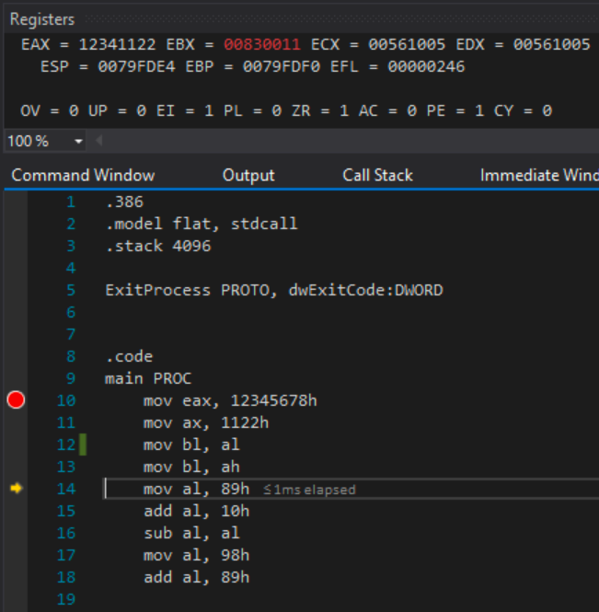



Debug: Line 13
To execute line 13, Select ‘Step over’ from debug menu
You can also use shortcut : Fn+F10
Mov bl, ah
Here the content of AH register is moved to the BL register.
AH register is the upper 8-bit of the AX register.
It contains 11 now.
11 is a hex
BL is the lower 8 bit of EBX register
BL is the destination here
After executing this line, BL contains 11 as well. However, rest of the EBX register remains unchanged with previous garbage values.

Slide 33
Add and Sub instruction
add instruction has two inputs – first one is destination and second one is source.
add destination, source
add instruction adds the source content to the destination and store the result in destination.
For example,
add al, 12h
Adds 12 to the content of AL register and store the result in AL register
It is more like : al = al + 12 in a high level language
sub instruction is similar to add instruction
Instead of addition it performs subtraction.

Slide 34
Submission : Lab 3(b)
Debug the rest of the code one line at a time.
There is an answer sheet provided with the lab.
After executing each line record the register value in the answer sheet.
Then also provide short explanation for the changes.
Submit the filled-out answer sheet at iCollege.

Slide 35
Processor Clock
A review

Slide 36
Clock
Each processor has a built-in clock to synchronize the internal operations.
Each CPU operation synchronized by an internal clock pulsing at constant rate.
A clock is a sequence of 1’s and 0’s
Clock Cycle: a 0 and 1 produce a clock cycle
Frequency: The number of cycles happens per second
Unit : Hz = 1 cycle per second

Slide 37
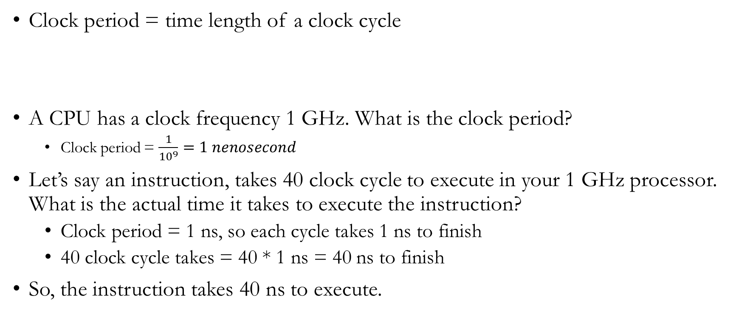
Clock
Clock period = time length of a clock cycle
A CPU has a clock frequency 1 GHz. What is the clock period?
Clock period = $\frac{1}{{10}^{9}}=1 nenosecond$
Let’s say an instruction, takes 40 clock cycle to execute in your 1 GHz processor. What is the actual time it takes to execute the instruction?
Clock period = 1 ns, so each cycle takes 1 ns to finish
40 clock cycle takes = 40 * 1 ns = 40 ns to finish
So, the instruction takes 40 ns to execute.

Slide 38
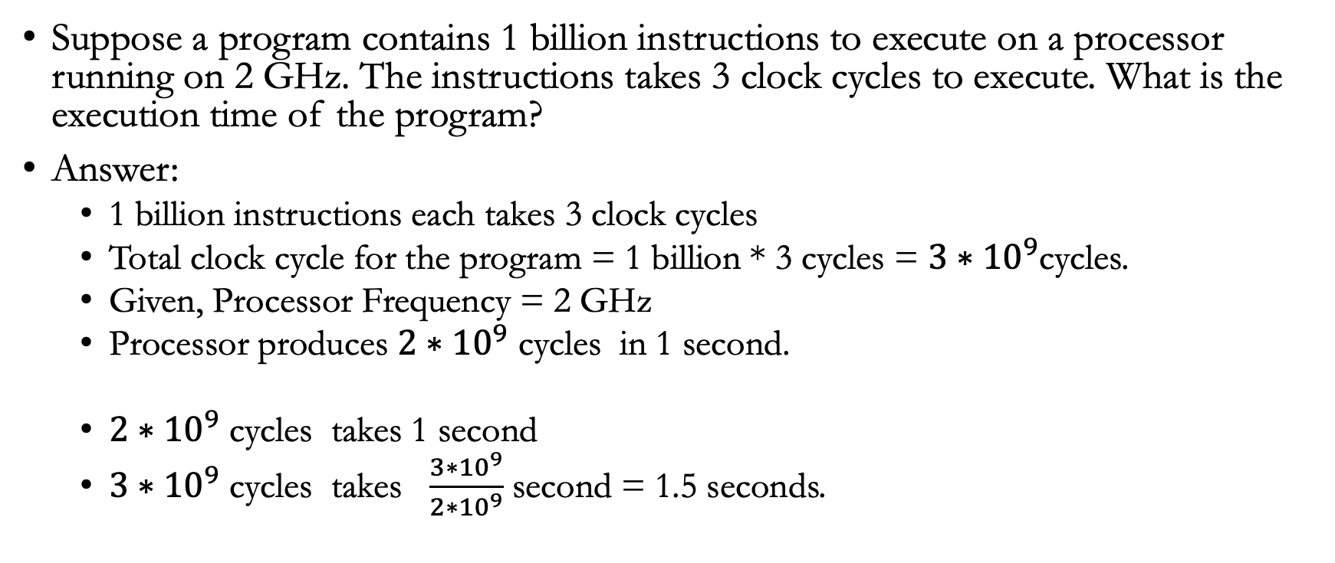
An example
Suppose a program contains 1 billion instructions to execute on a processor running on 2 GHz. The instructions takes 3 clock cycles to execute. What is the execution time of the program?
Answer:
1 billion instructions each takes 3 clock cycles
Total clock cycle for the program = 1 billion * 3 cycles = ${3∗10}^{9}$cycles.
Given, Processor Frequency = 2 GHz
Processor produces ${2∗10}^{9}$ cycles in 1 second.
${2∗10}^{9}$ cycles takes 1 second
${3∗10}^{9}$ cycles takes $\frac{{3∗10}^{9}}{{2∗10}^{9}}$second = 1.5 seconds.

Slide 39
Clock per Instruction (CPI)
Is an effective average.
It is the average number of clocks required by the instructions in a program.
In a program 30% instructions takes 4 clock cycles, and the rest of the instructions takes 1 clock cycles.
CPI = 0.3 * 4 + 0.7 * 1 = 1.9 clocks per instruction.

Slide 40
Million Instructions Per Second
Step 1: Perform Divide operation between no. of instructions and Execution time.
Step 2: Perform Divide operation between that variable and 1 million for finding millions of instructions per second.
For example,
if a computer completed 2 million instructions in 0.10 seconds
2 million/0.10 = 20 million.
No of MIPS =20 million/1 million
= 20

Slide 41
Lab 3(c) Some math Problems
Submit the problems

Slide 42
Lab 3(c) : Submission
Solve the Problems provided in slide 45 and 46.
You can do your work in a text editor (Microsoft word, open office, etc.)
Or you can do it in a piece of paper, then scan or take a picture of the paper.
Convert them into pdf and submit in the iCollege.

Slide 43
Problem 1
Suppose a program contains 500 million instructions to execute on a processor running on 2.2 GHz. Half of the instructions takes 3 clock cycles to execute, where rest of the instructions take 10 clock cycle. What is the execution time of the program?

Slide 44
Problem 2
A processor is 20 MIPS. If you run a program on that processor and the program takes 30 seconds to finish. How many instructions are there in this program?

